Slide 1
Fabrication and Design of Fork Lift
NITTE MEENAKSHI INSTITUTE OF TECHNOLOGY
MINI PROJECT
NAME-USN GUIDE
Kalyan B-1NT15ME203 Dr . Madhusudan Rao

Slide 2
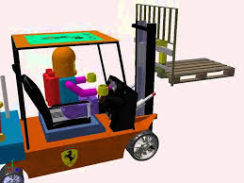
INTRODUCTION
Building a remote controlled fork lift for the better use of area around and reduce stress to humans
This basically works on three motors ,one to lift one to move front and back, one to move right and left.

Slide 3
PROBLEM STATEMENT
THIS WILL REDUCE STRESS ON HUMANS AND SIMPLIFY THE WORK
SIMPLE MECHANISM , CAN BE DONE IN HOME
IT WILL MAKE THE WORK FASTER
LIFTS WITH EASE

Slide 4
WORKING
COUNTERWEIGHT-IT IS A MASS ATTACHED TO THE REAR OF FORK LIFT TO COUNTER ACT THE ORIGINAL WEIGHT
POWER SOURCE-THIS FORK LIFT MOTORS ARE PROVIDED WITH THE NORMAL 12V BATTERY SYSTEM
SLIDER-IT IS A VIRTICAL ASSEMBLY WHICH DOES THE LIFTING AND LOWERING OF THE MASS
SWITCH-USED TO CHANGE THE DIRECTION OF MOTOR W.R.T DIRECTION OF MOTION

Slide 5
TYPES OF FORK LIFT
PALLET JACK
RIDER MOTORIZED PALLET TRUCK
HIGH LIFT PALLET TRUCKS
FRONT RIDER PALLET TRUCKS
AGVs

Slide 6
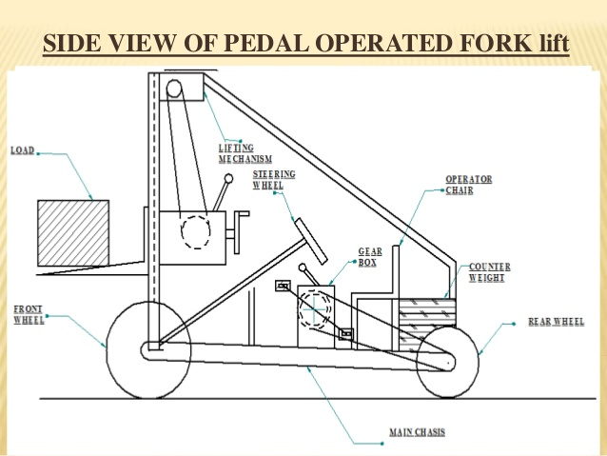

Slide 7
COMPONENTS USED
DRIVING CHAIN
LIFTING CHAIN
FORK
SHAFT
GEARED MOTOR
TENSIONER
BEARING
WHEEL MOTOR

Slide 8
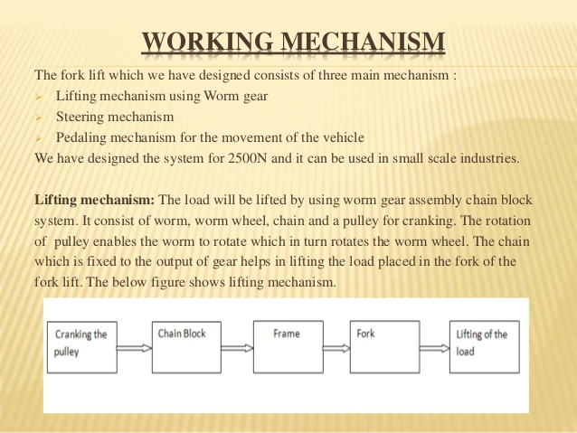

Slide 9
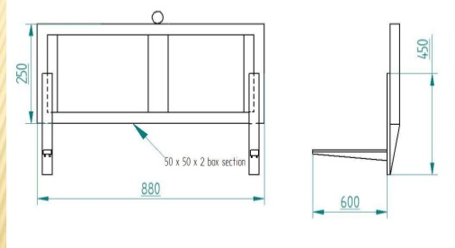
SIDE FRAME

Slide 10
FUTURE SCOPE
MAIN AIM IS TO HELP OUT THE SMALL SCALE INDUSTRIES
IT IS NOT APPLICAPLE FOR SLOPPY AREAS AS THE C.G WOULD CHANGE AWAY.
AS PER PRESENT SITUAATION MORE CASUALTIES OCCUR DUE TO HEAVY WEIGHT LIFT PROCESS

Slide 11
CONCLUSION
THE MAIN ADVANTAGE OF USING THIS TECH IS TO INCREASE THE SAFETY OF OPERATORS

